Slide 1
The Problem
Target Customers
When and Where
Transport companies that deliver passengers on vehicles with standing space.
It happens whenever there are standing passengers on vehicles.
Transport companies want standing space in vehicles but standing passengers need to keep themselves upright.
WHY: Safety
WHY: Efficiency
Falls can cause serious injuries to passengers. Furthermore, transport companies want potential passengers to consider their vehicles safe.
Standing space is more space efficient than seats. Moreover, higher capacity means waiting passengers do not need to worry about insufficient seats.

Slide 2
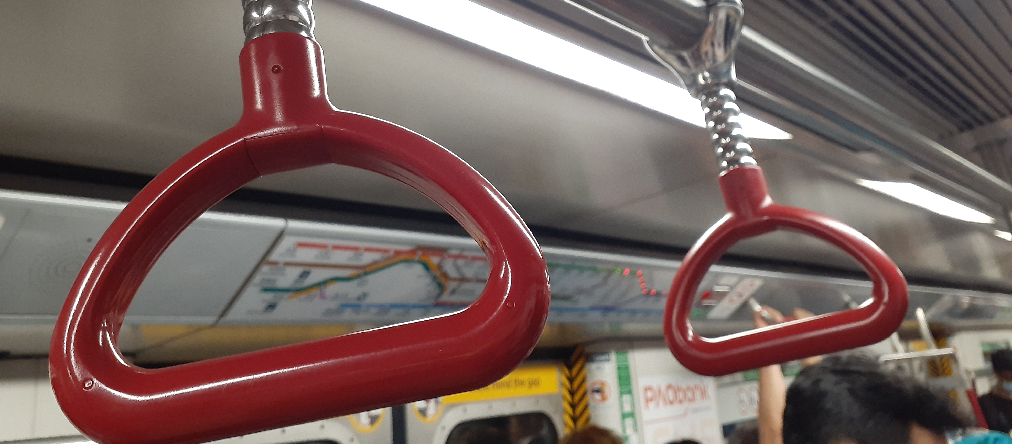
Problems With Existing Solutions: Handrails
Ride Experience
Fomite
In 2022, the average commute time in Hong Kong is 44 minutes.^{[1]} Holding the handrails for a long time takes effort and is uncomfortable. Also, passengers only have one free hand to hold things.
As the handrails are held by many different people daily, handrails are contaminated with pathogens. This may cause passengers to become sick. Another thing is that passengers feel dirty after holding the handrails.
https://moovitapp.com/insights/en/Moovit_Insights_Public_Transit_Index-countries
Notes:
- HK KTD MTR Kwun Tong Line train red rings July 2021 SS2 01.jpg: Towamng Yama Kittyzi, CC BY-SA 4.0 <https://creativecommons.org/licenses/by-sa/4.0>, via Wikimedia Commons

Slide 3
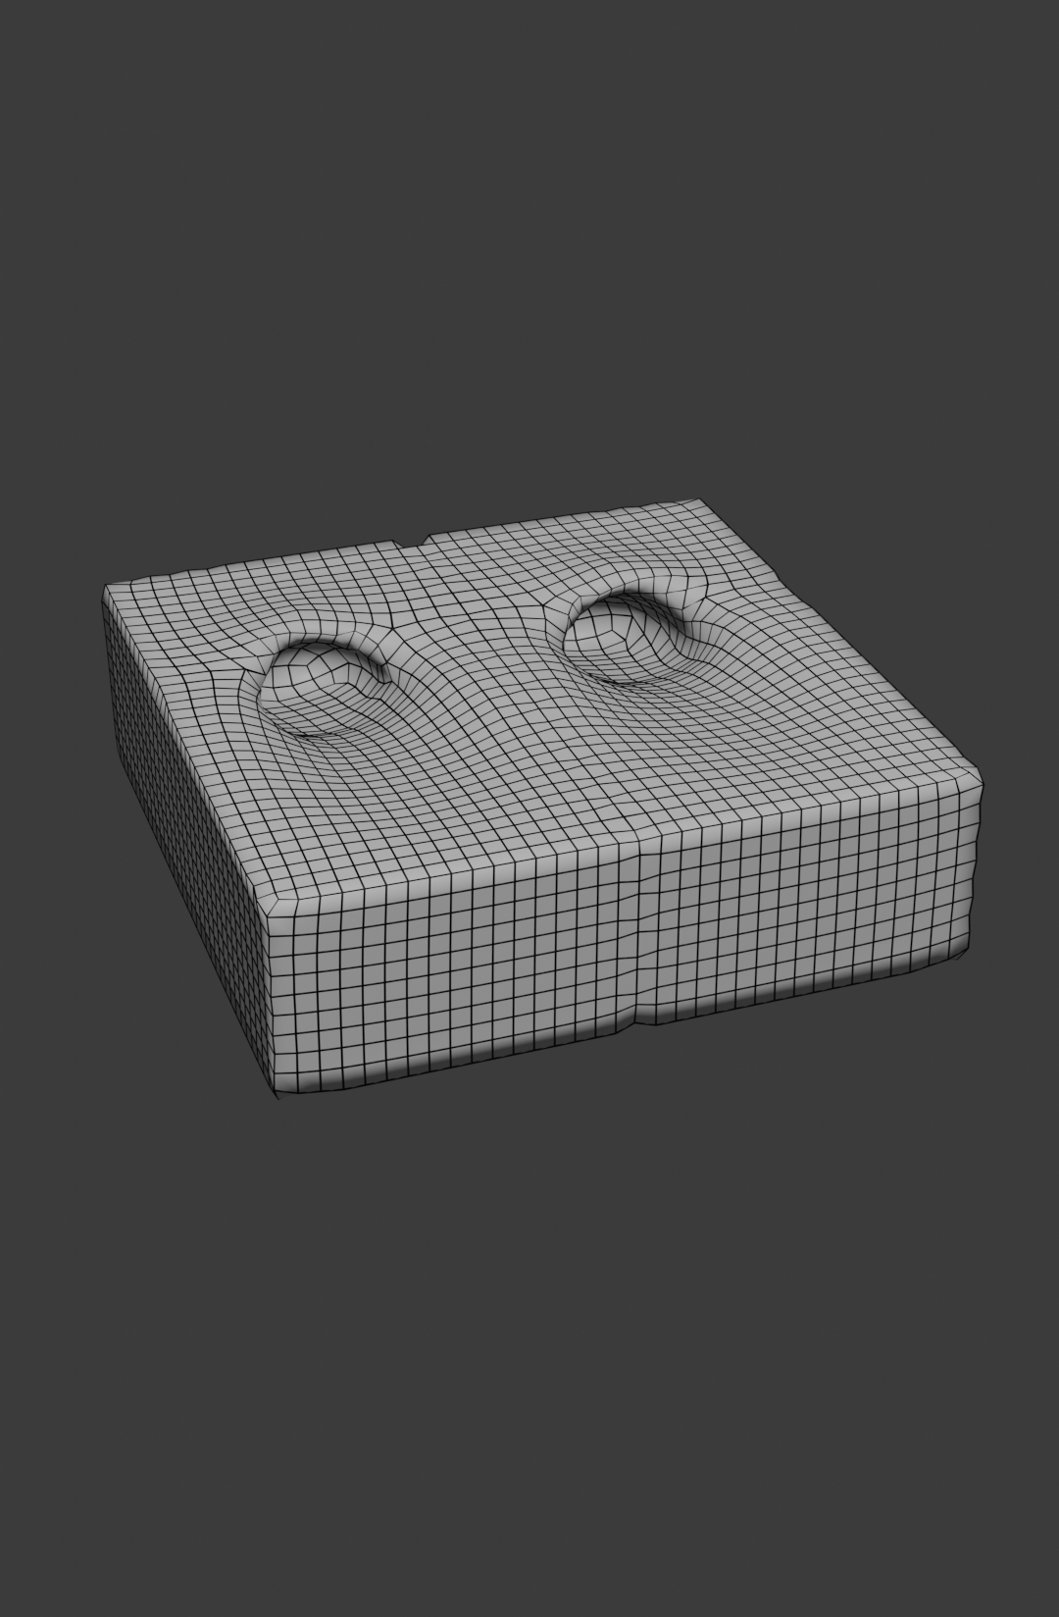
The Solution
An elevated ground platform with rough slanted holes that can fit passenger shoes inside.
Tackling the Problem
Improvements Over Existing Solutions
Passengers can place their feet inside shoes into the holes to keep themselves upright.
Keeping passengers’ feet inside the holes takes less effort and does not make their hands dirty.
Hypothesis: Space Efficiency
Hypothesis: Retrofittable
As the holes are embedded into the ground, it does not obstruct movement, whereas handrails do.
The ground platform can be added to existing vehicles, with a slope surrounding it, without changing other things.

